Slide 1
Weekly report 19th March 2018
Huy-Hung Ho
Key Laboratory for Smart Integrated Systems (SISLAB),
VNU University of Engineering and Technology (VNU-UET)

Slide 2
Completed work
Read haft of the papers of LSI Contest 2018
Tested Matlab for handwritten-digit recognization

Slide 3
Next week
Design Forward ANN less modularization (50%)
Test MNIST (only simulation)
Deadline: 22/03
Insert SC to Forward ANN
Test MNIST
Read the remaining paper and presentation
Disscuss about 1 LFSR

Slide 4
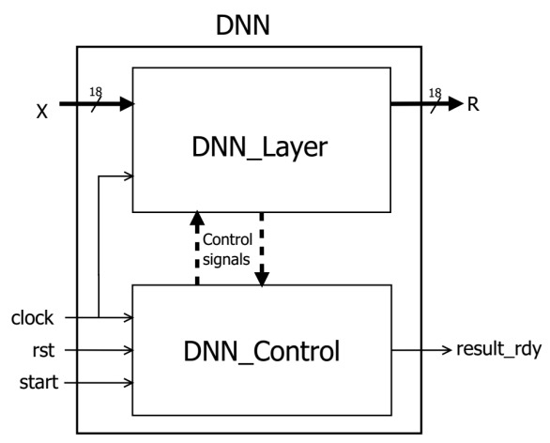
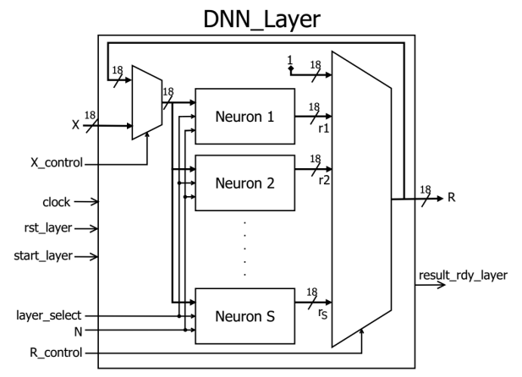
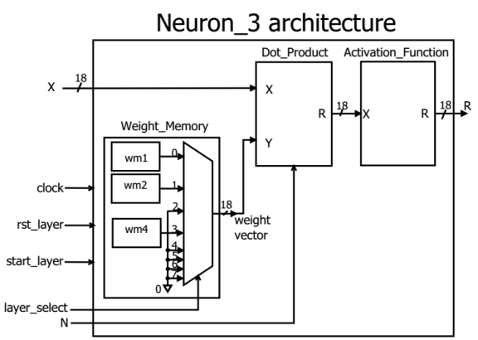
Low-area DNN architecture
+ Stochastic Computing

Slide 5
Meeting result
Main task: Writing outline, thesis
Deadline: 09/04
Completing demo: MNIST + SC in Forward
Completing Backward
Design 1 LFSR -> paper/pattent

Slide 6
THANKS FOR YOUR ATTENTION

